Slide 1
Week 1
Basics of Python

Slide 2
Summary for Week 1
Differences between Python and R
Python basics:
Data types
Loops
Conditional statements
List comprehension
Installing Python
Installing packages (pip/conda)
Setting up a Python environment

Slide 3
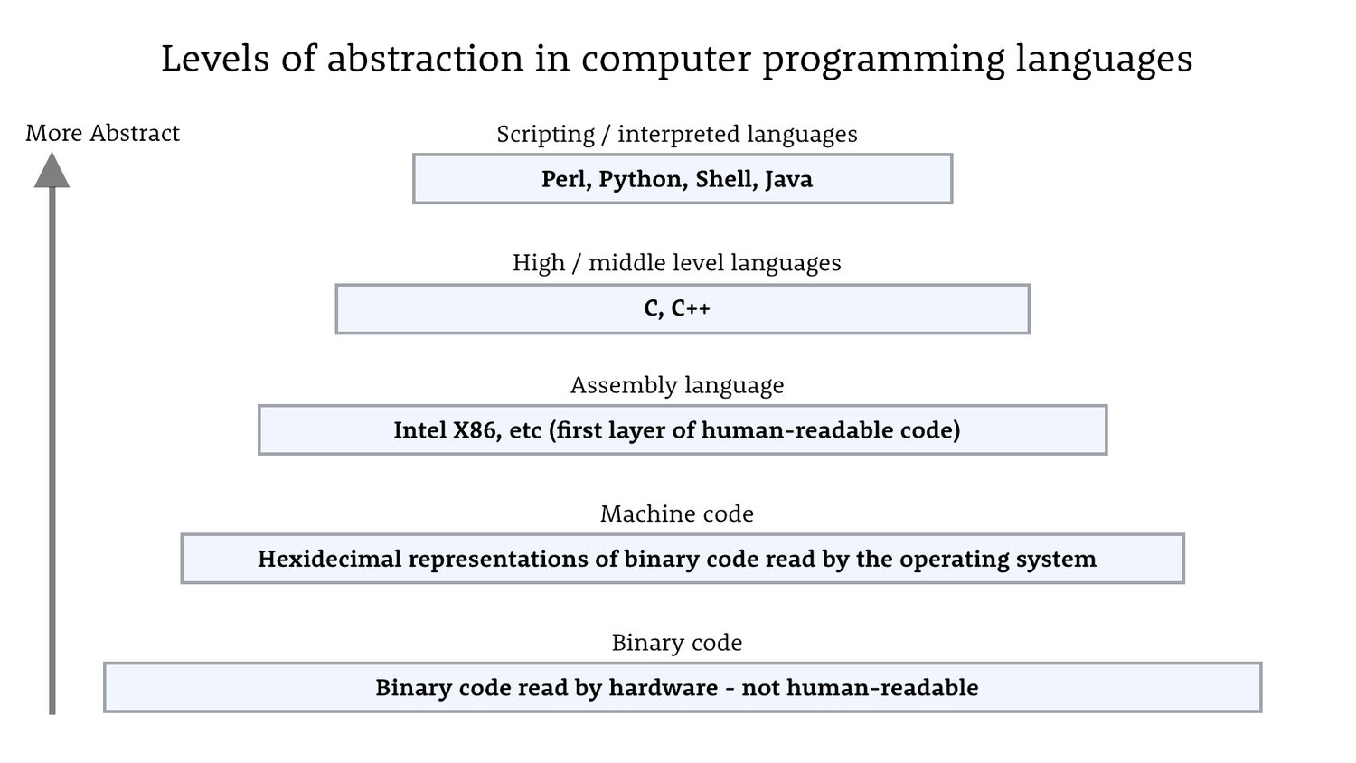
Statistical Languages: e.g. R/Stata
written in C++, higher level than python as less ‘hard coding’ is required
Notes:
Binary: 0s and 1s (flow of current on/off)
Grouping binary strings together for more complex instructions
Machine code: binary digits representing each letter
Assembly: moving/combining memory around (move/add/subtract)
Middle level: C/C++ needs to define everything: reserve memory, saying where to put data open/close processes, cleaning memory
Python built on C++
Scripting: make code read like human language
Hard coding: python might need to build from scratch, R may have a model function which does all the functionality e.g. ols(y~x)
Hides detail (python more customisable for modelling code)

Slide 4

Python vs R
Useful guide here:
https://www.mit.edu/~amidi/teaching/data-science-tools/conversion-guide/r-python-data-manipulation/
Python | R
General purpose - Used in various domains | Primarily for stats/visualisation
Large community adding + updating 3rd party code | Vast collection of stats packages but some outdated, generally used in academia more than anywhere else
Easier to learn due to more similar to English and clean syntax – has a style guide e.g. lower case for variables, upper case for classes | Can have convoluted syntax

Slide 5

Data Types
Notes:
Ask class if they do not recognise these
Integers (int): Used to represent whole numbers (e.g., 42, -10, 0).
Floating-Point Numbers (float): Used to represent real numbers with a decimal point (e.g., 3.14, -0.5).
Strings (str): Used to represent text or characters (e.g., "Hello, World!").
Booleans (bool): Used to represent true or false values (e.g., True, False).
Lists (list): Ordered collections of elements that can have mixed data types (e.g., [1, 'apple', True]).
Tuples (tuple): Ordered, immutable collections of elements (e.g., (1, 2, 3)).
Dictionaries (dict): Unordered collections of key-value pairs (e.g., {'name': 'Alice', 'age': 30}).
Sets (set): Unordered collections of unique elements (e.g., {1, 2, 3}).
NoneType (None): Represents the absence of a value or a null value.

Slide 6
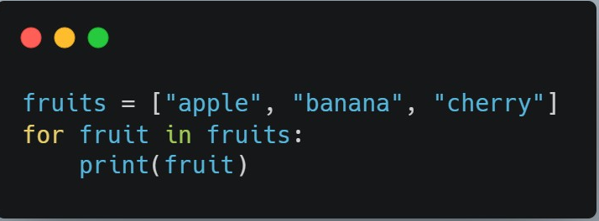
Loops
Allow you to execute a block of code repeatedly.
Two main types `for` and `while` loops.
Notes:
For Loops
`for` loops are used to iterate over a sequence (such as a list, tuple, or string)
They have a fixed number of iterations based on the length of the sequence.
While Loops:
- `while` loops are used to repeatedly execute a block of code as long as a certain condition is true.
- They have a variable number of iterations based on the condition.

Slide 7
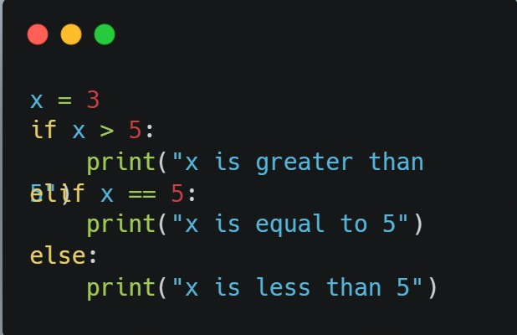
Conditional statements
Used to control flow of your code,
i.e. execute this if a condition is `True` or `False`.
Notes:
1. `if` Statement:
The `if` statement is used to execute a block of code if a given condition is `True`.
2. `elif` Statement:
The `elif` statement allows you to specify additional conditions to be tested if the initial `if` condition is not met.
3. `else` Statement:
The `else` statement is used to execute a block of code if none of the preceding conditions are `True`.

Slide 8
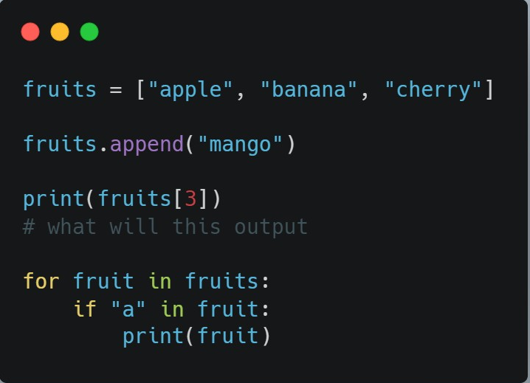
List comprehension
Lists are used to store/delete/add items
They are very useful for a variety of tasks

Slide 9


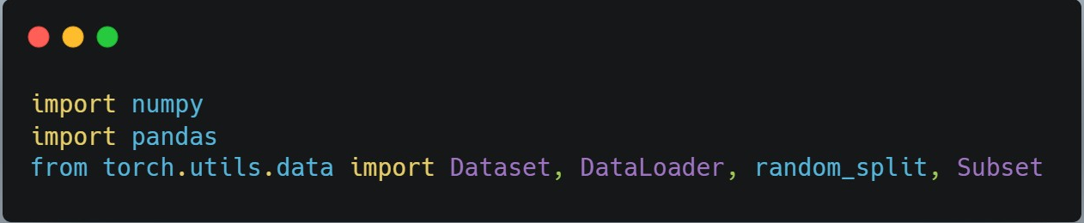
ENVIRONMENTS AND PACKAGES
Conda is an open source Python package and environment management system.
For these workshops we will use a small version of conda called miniconda – install it here: https://docs.conda.io/projects/miniconda/en/latest/miniconda-install.html
The syntax for importing 3rd party modules/pieces of code is like this:
Python's ecosystem has inbuilt and third-party packages.

Slide 10
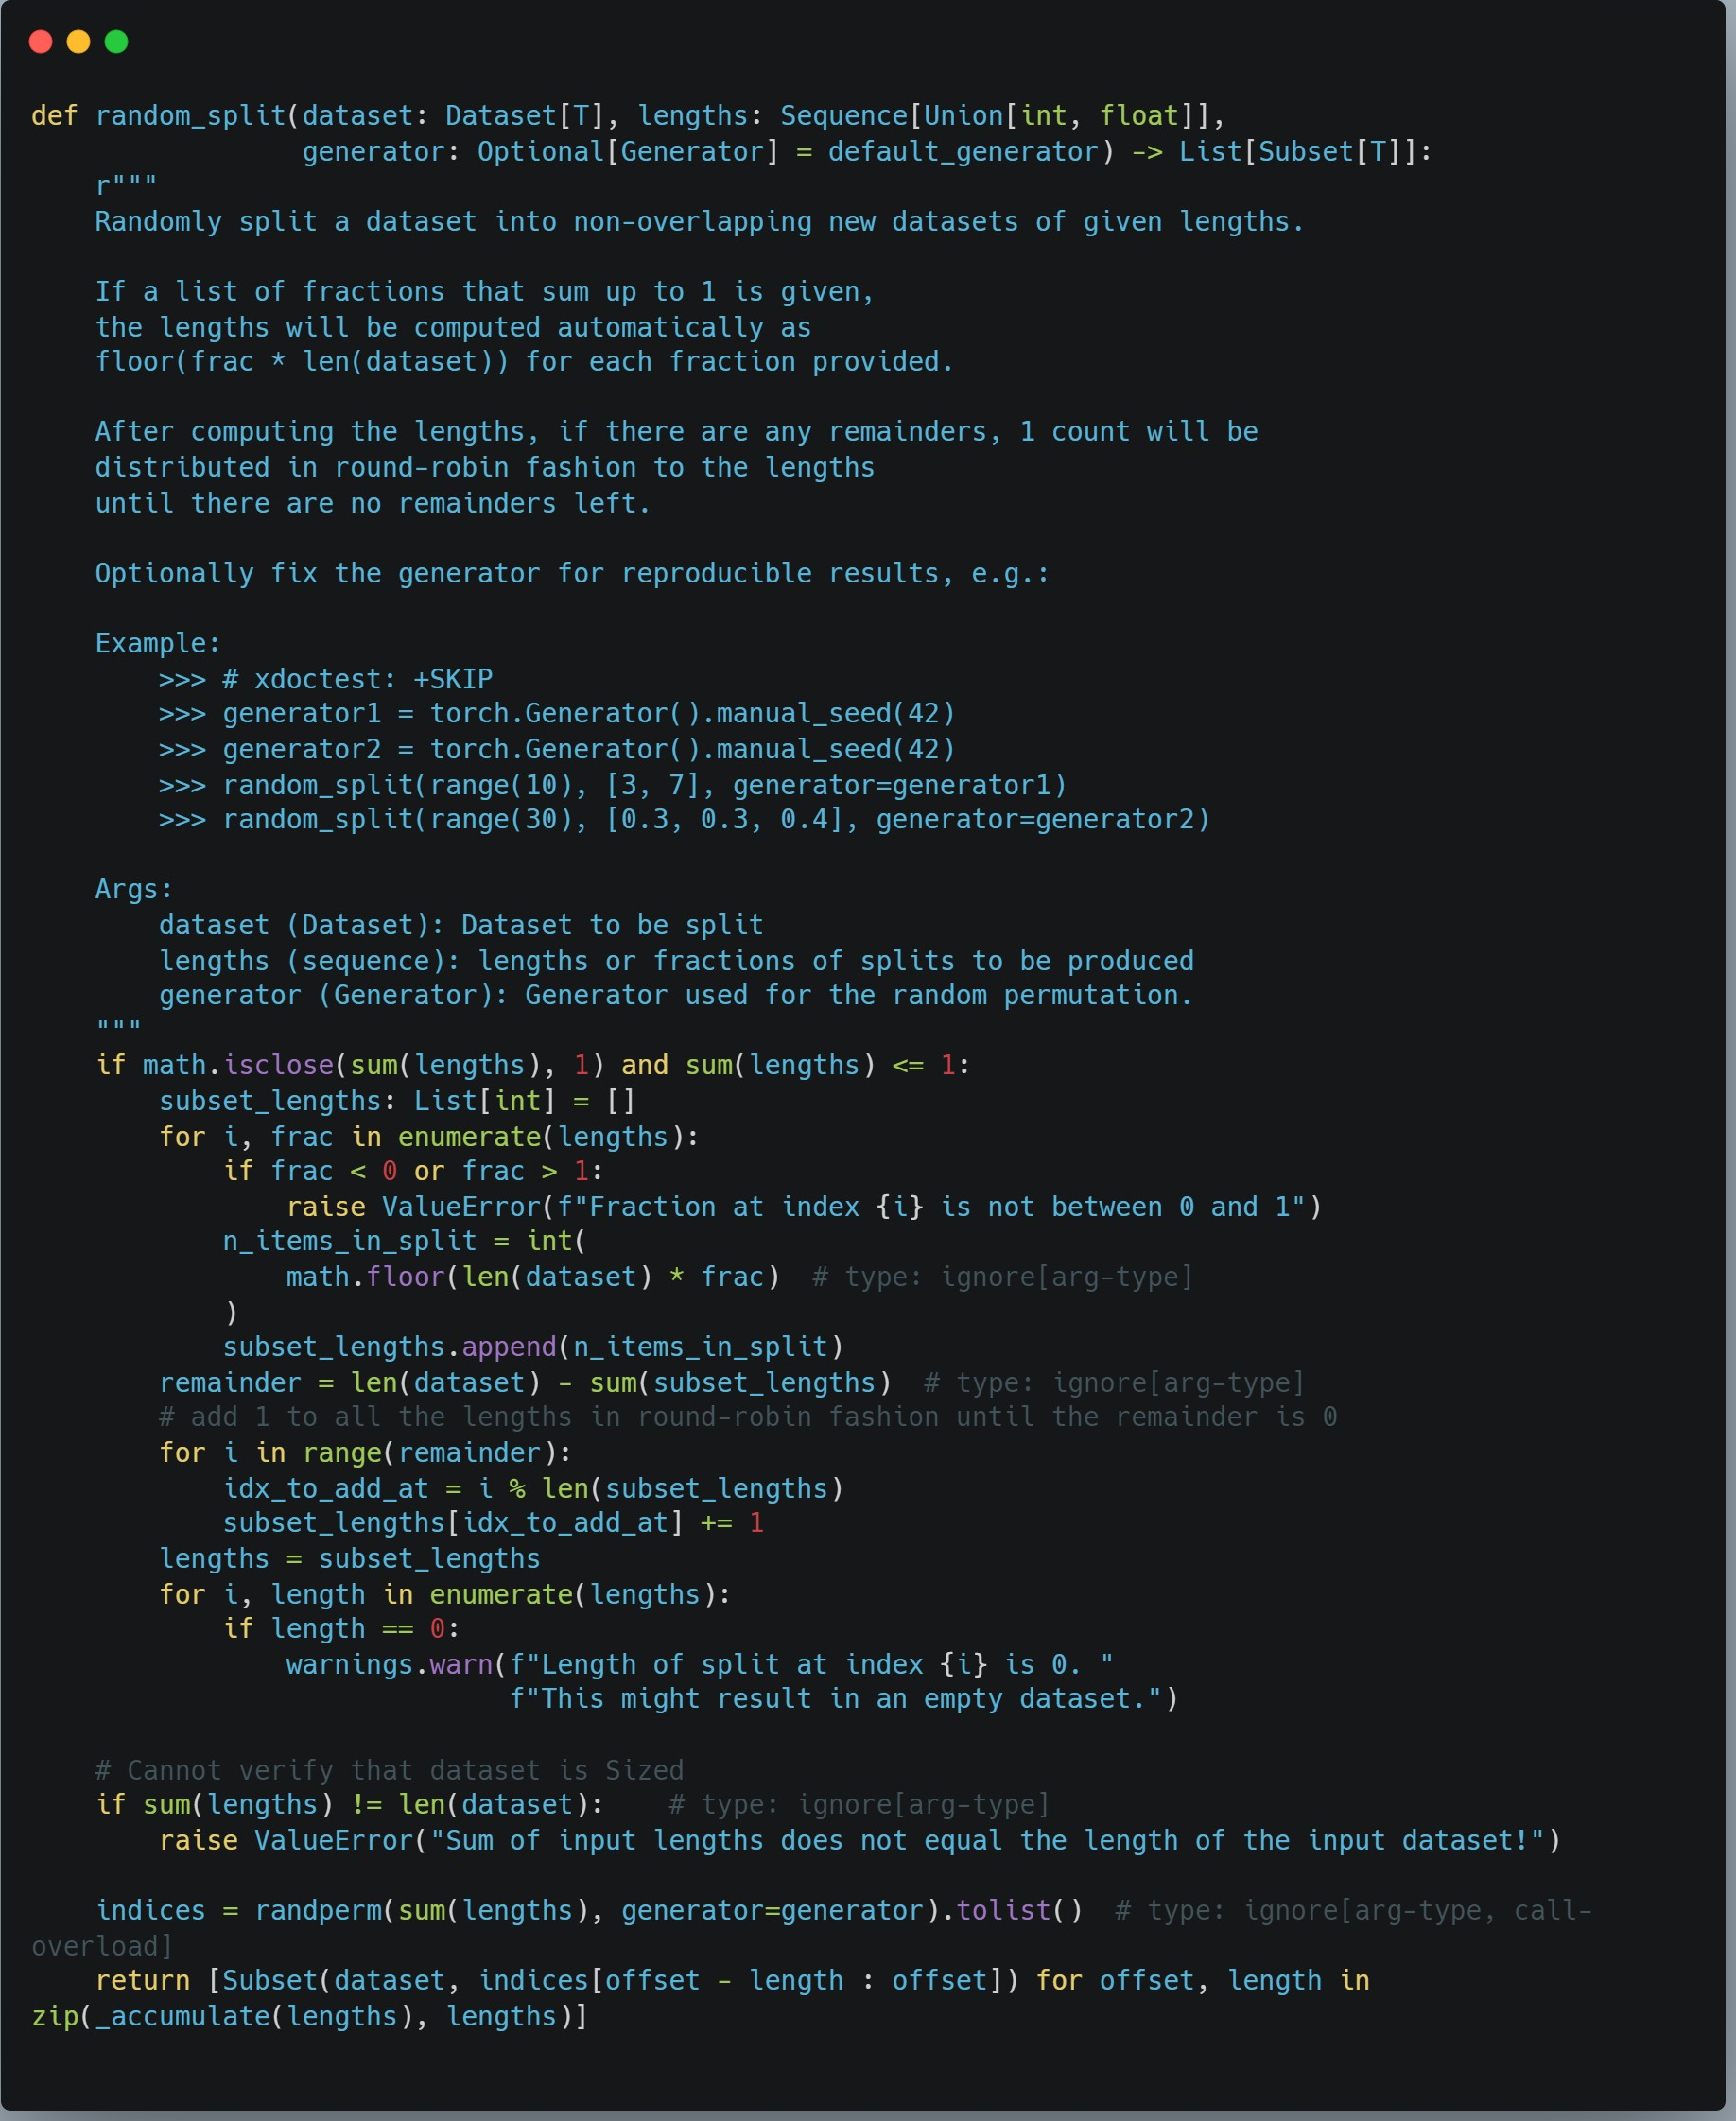
Example of import code and what its referring to
When you download packages all these scripts are stored on your computer in package files. Conda manages how these are stored

Slide 11
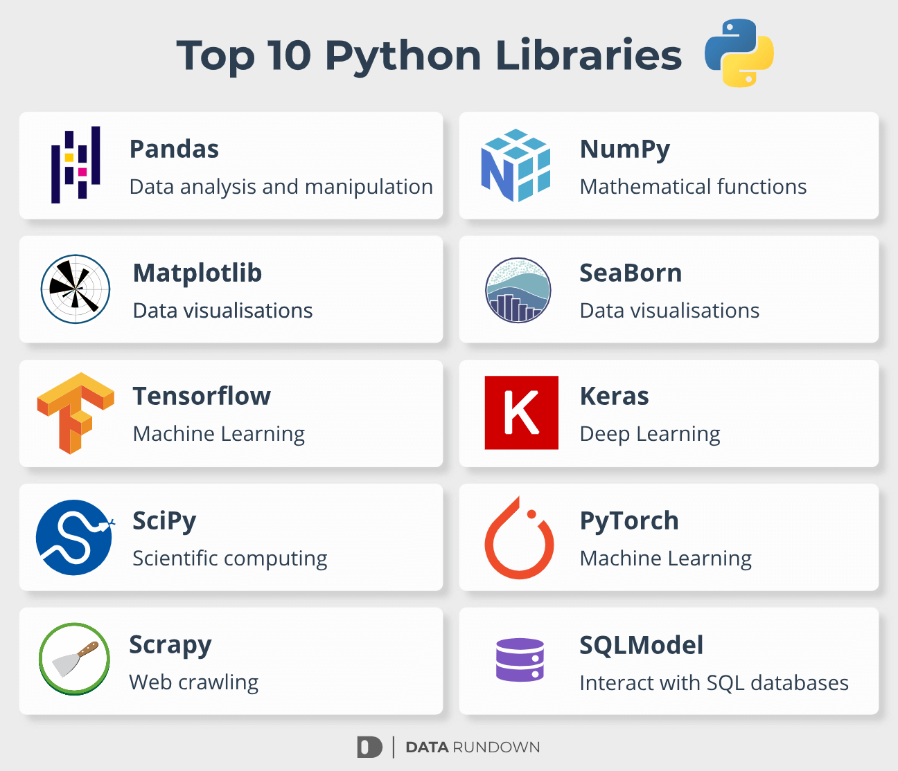

Slide 12
Lab Notebook Setup

Slide 13

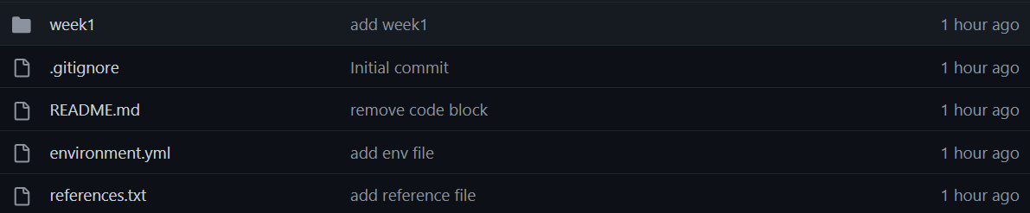
Step 1:
Create a folder for these workshops in your local files [ Hestia_Python_Practicals ]
Step 2: go to https://github.com/benkeel/hestia_python_practicals/tree/main
+ download zip of github repo
Step 3:
Extract zip folder

Slide 14

Create Virtual Environment
Mac/Linux users: Open a Terminal
Windows users: Open Anaconda prompt
Change to the correct directory [copy file path]:
cd path/to/directory
Then run the following command:
conda env create -f environment.yml
or
conda create –n hestia numpy pandas seaborn matplotlib
Notes:
A virtual environment is an isolated environment that can help to keep interpreters and dependencies required by different projects separate.
The benefit is you can create and delete these environments without affecting the root one. It also allows you to freeze the environment specifically for the project/module.
Even though you can use the environment in Anaconda, I suggest here to setup a virtual environment specifically for GEOG0051.

Slide 15

Any Questions?
Notes:
Using Git?
[How to install git
How to pull ]

